Slide 1
HTML&CSS ——你(可能)没见过的船新语言
寒假训练项目-Week2
主讲人：宋宸韬
日期：2023/1/27

Slide 2
目 录
上周知识回顾
HTML语言讲解
CSS语言讲解
Workshop
Contents

Slide 3
前情提要
Week1中我们学习了：
Linux的安装与使用
常用指令回顾：pwd、ls、cd、touch、mkdir、rm、cat、echo
配套工具：vim、ssh、tmux
Docker的使用方法
docker run
docker exec
docker build
docker file
docker ps -a
docker images

Slide 4
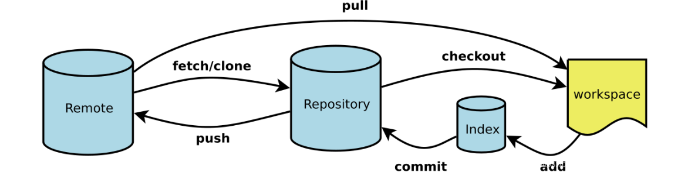
Git自测
5
4
3
2
1

Slide 5
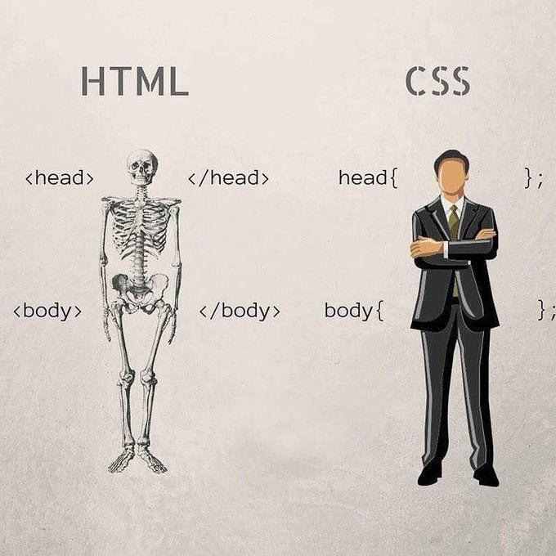
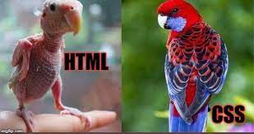
Html和Css是做什么的？

Slide 6
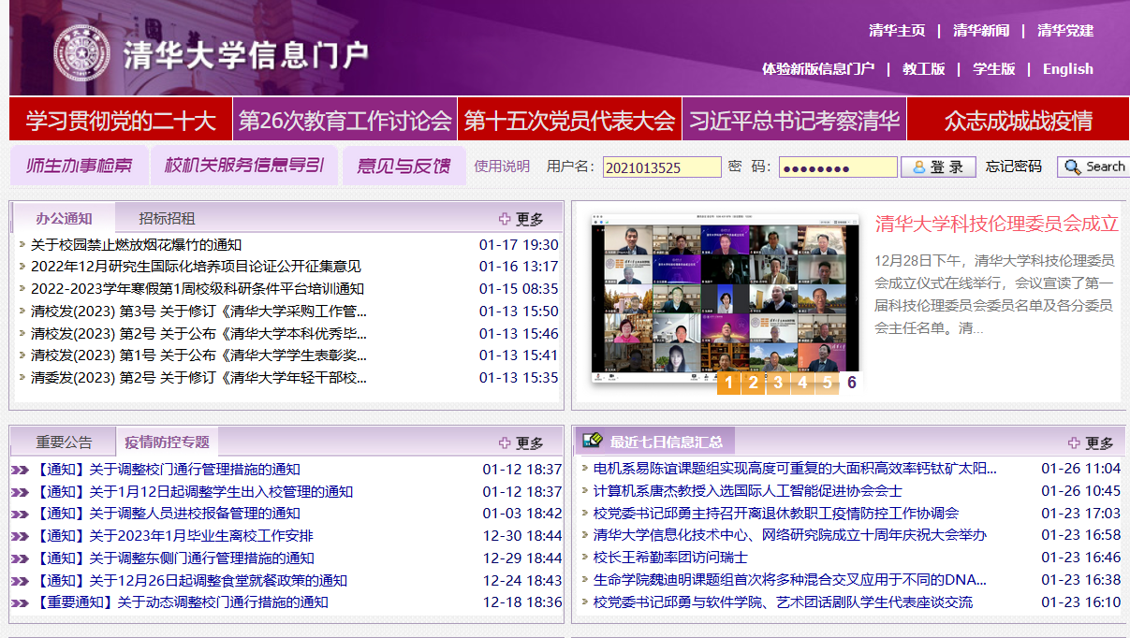
Html：嵌套起来的box

Slide 7
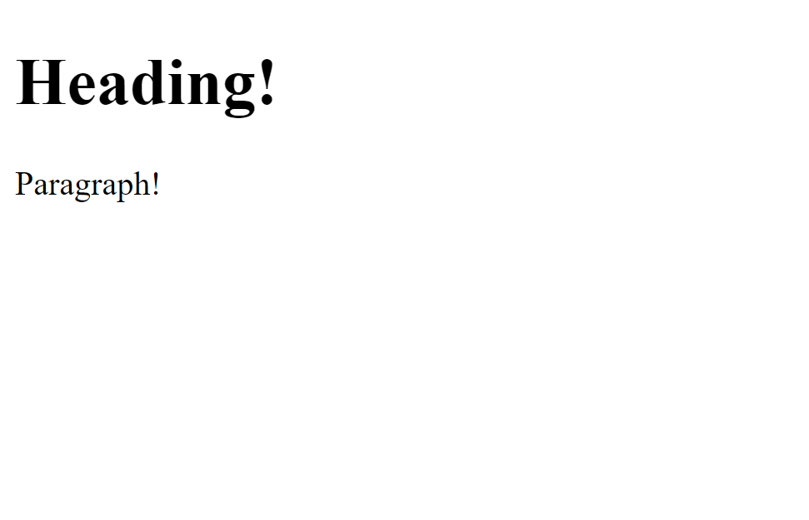
一个Html页面通常的组成模式
<!DOCTYPE html> <html> <head> <title>Title!</title> </head> <body> <h1>Heading!</h1> <p>Paragraph!</p> </body> </html>

Slide 8
hello.html
<!DOCTYPE html> <html> <head> <title>Title!</title> </head> <body> <h1>Heading!</h1> <p>Paragraph!</p> </body> </html>
Notes:
this makes sure page uses latest html and not some random fallback version

Slide 9
hello.html
<!DOCTYPE html> <html> <head> <title>Title!</title> </head> <body> <h1>Heading!</h1> <p>Paragraph!</p> </body> </html>
Notes:
root

Slide 10
Html元素（box)
<!DOCTYPE html> <html> <head> <title>Title!</title> </head> <body> <h1>Heading!</h1> <p>Paragraph!</p> </body> </html>
<html>
-content-
</html>

Slide 11

Notes:
If you want more details, you can look at the structure of HTML as the “DOM” (Document Object Model). It is how HTML is represented in memory and can be worth looking more into if you want more background.

Slide 12
hello.html
<!DOCTYPE html> <html> <head> <title>Title!</title> </head> <body> <h1>Heading!</h1> <p>Paragraph!</p> </body> </html>
Notes:
note that heading/body tags come preset with styling, this can be overwritten

Slide 13
hello.html
<!DOCTYPE html> <html> <head> <title>Title!</title> </head> <body> <h1>Heading!</h1> <p>Paragraph!</p> </body> </html>
Notes:
Title for document, scripts, styles, general information about the data on the page (“metadata”) (information for the browser and search engines)
https://developer.mozilla.org/en-US/docs/Glossary/Head

Slide 14
hello.html
<!DOCTYPE html> <html> <head> <title>Title!</title> </head> <body> <h1>Heading!</h1> <p>Paragraph!</p> </body> </html>

Slide 15
hello.html
<!DOCTYPE html> <html> <head> <title>Title!</title> </head> <body> <h1>Heading!</h1> <p>Paragraph!</p> </body> </html>
Notes:
if we go back to xkcd...

Slide 16
hello.html
<!DOCTYPE html> <html> <head> <title>Title!</title> </head> <body> <h1>Heading!</h1> <p>Paragraph!</p> </body> </html>

Slide 17
hello.html
<!DOCTYPE html> <html> <head> <title>Title!</title> </head> <body> <h1>Heading!</h1> <p>Paragraph!</p> </body> </html>

Slide 18
hello.html
<!DOCTYPE html> <html> <head> <title>Title!</title> </head> <body> <h1>Heading!</h1> <p>Paragraph!</p> </body> </html>
Notes:
Everything not in tags is text

Slide 19
更多Html元素
<html>
<head>
<body>
<h1>, <h2>, <h3>, …
<p>
<div>
标题
段落
分组元素（没有特定含义）

Slide 20
Html属性：元素的附加信息
<tagname>
content
</tagname>
Opening tag
Closing tag

Slide 21
Html属性：元素的附加信息
<tagname abc="xyz">
content
</tagname>
Opening tag

Slide 22
Html属性：元素的附加信息
<a href="link here">
content
</a>
Opening tag

Slide 23
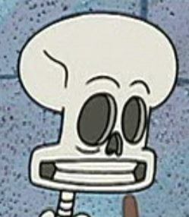
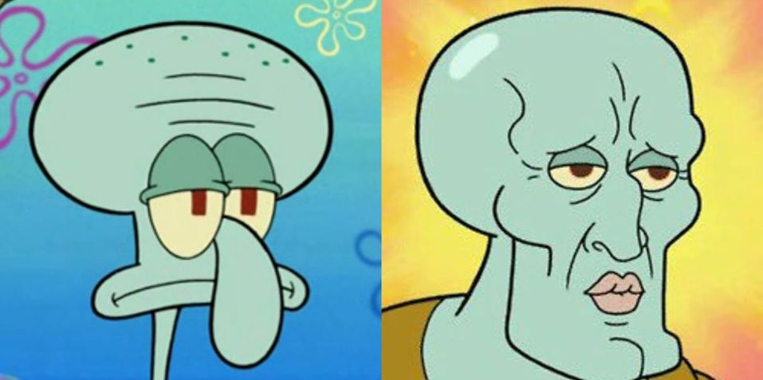
CSS = 网站长什么样子
HTML HTML + CSS HTML + a lot of CSS

Slide 24
CSS 语法
div {
color: red;
font-family: Arial;
font-size: 24pt;
}
<link rel="stylesheet" href="style.css" />
Notes:
this is an example “CSS rule”
https://developer.mozilla.org/en-US/docs/Web/CSS/CSS_Selectors

Slide 25
hello.html
<!DOCTYPE html> <html> <head> <title>Title!</title> </head> <body>
<h1>Heading!</h1> <div>Paragraph!</div> </body> </html>
Heading
Paragraph!
Notes:
using div instead of p for the sake of example

Slide 26
hello.html
Heading
<h1>Heading!</h1> <div>Paragraph!</div>
Paragraph!

Slide 27
hello.html
Heading
<h1>Heading!</h1> <div>Paragraph!</div>
<div>Info</div>
Paragraph!
Info

Slide 28
hello.html
<h1>Heading!</h1> <div>Paragraph!</div>
<div>Info</div>
Heading
Paragraph!
style.css
Info
div {
color: red;
font-family: Arial;
font-size: 24pt;
}
Notes:
stylesheets: your own personal makeup artist

Slide 29
hello.html
<h1>Heading!</h1> <div>Paragraph!</div>
<div class="info">Info</div>
Heading
Paragraph!
style.css
Info
div {
color: red;
font-family: Arial;
font-size: 24pt;
}

Slide 30
hello.html
<h1>Heading!</h1> <div>Paragraph!</div>
<div class="info">Info</div>
Heading
Paragraph!
style.css
Info
.info {
color: red;
font-family: Arial;
font-size: 24pt;
}
Notes:
Target ONLY elements with the class “info” to be red, Arial, etc.

Slide 31
hello.html
<h1>Heading!</h1> <div>Paragraph!</div>
<div id="unique">Info</div>
Heading
Paragraph!
style.css
Info
#unique {
color: red;
font-family: Arial;
font-size: 24pt;
}
Notes:
Target ONLY element with the id “unique” to be red, Arial, etc.

Slide 32
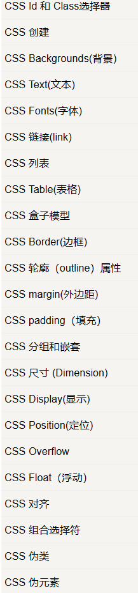
对元素的描述太多了？
https://www.runoob.com/css/css-tutorial.html
https://developer.mozilla.org/zh-CN/
Closing tag

Slide 33
Have a break
休息五分钟~

Slide 34
Workshop
git clone git@git.tsinghua.edu.cn:zhengcj20/asta-workshop.git
cd asta-workshop
git checkout w1-starter
git reset --hard

Slide 35
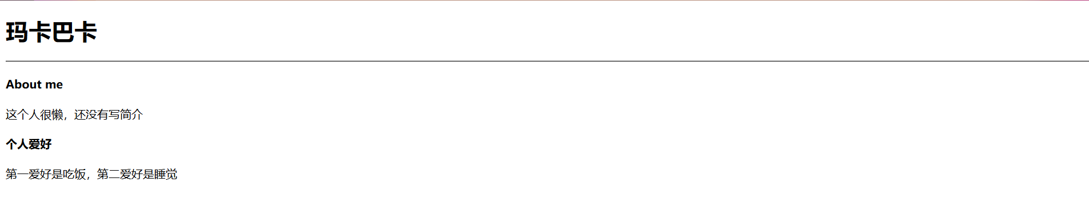
step1 文字

Slide 36
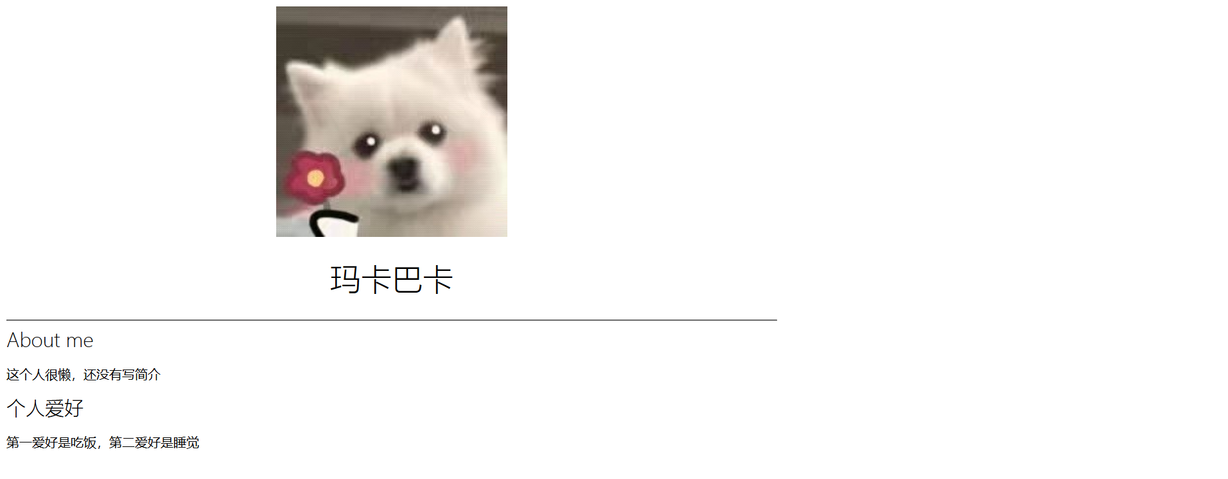
step2 头像

Slide 37
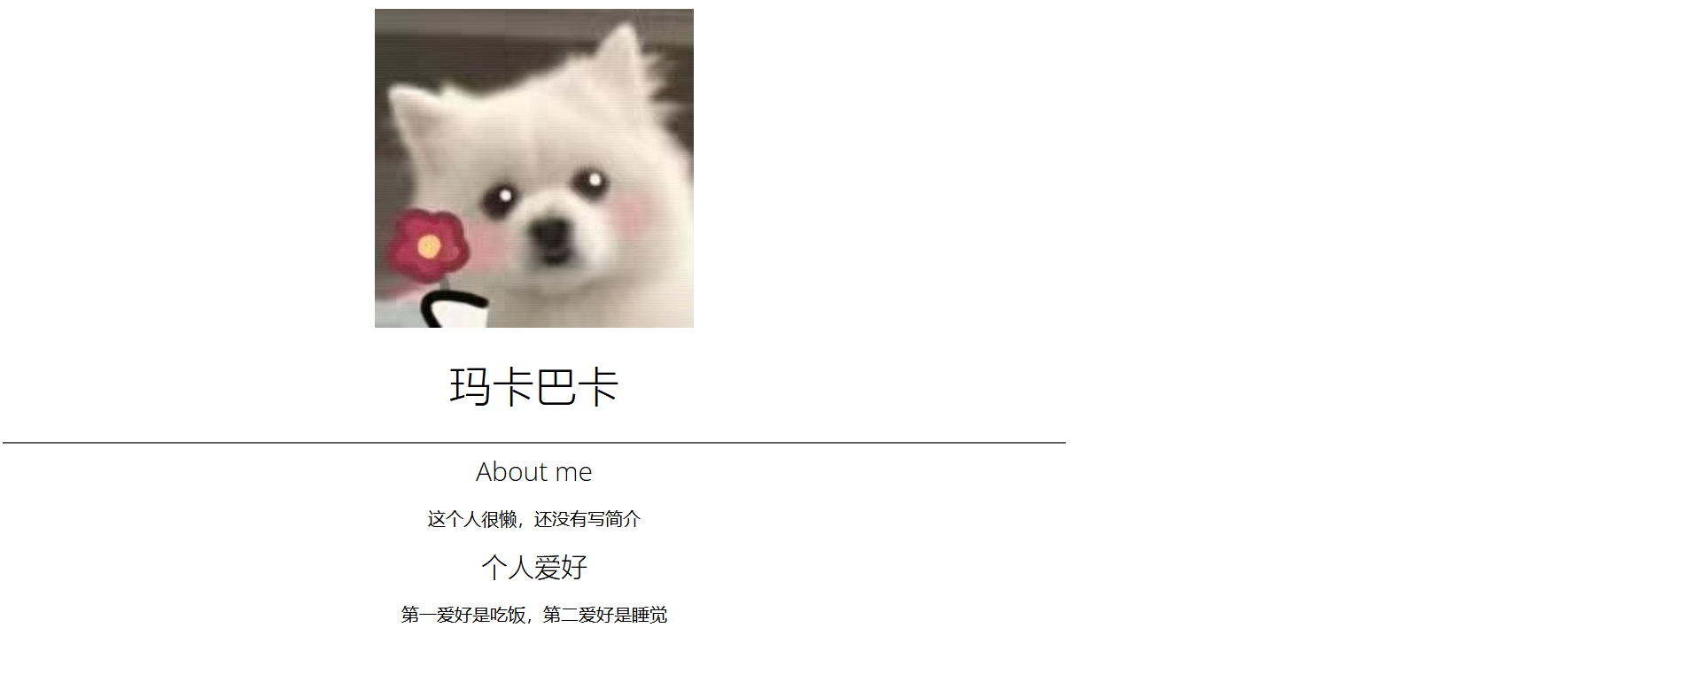
Step3、4 运用css进行居中

Slide 38

step5 改字体

Slide 39
step6 加入导航栏文字&颜色

Slide 40
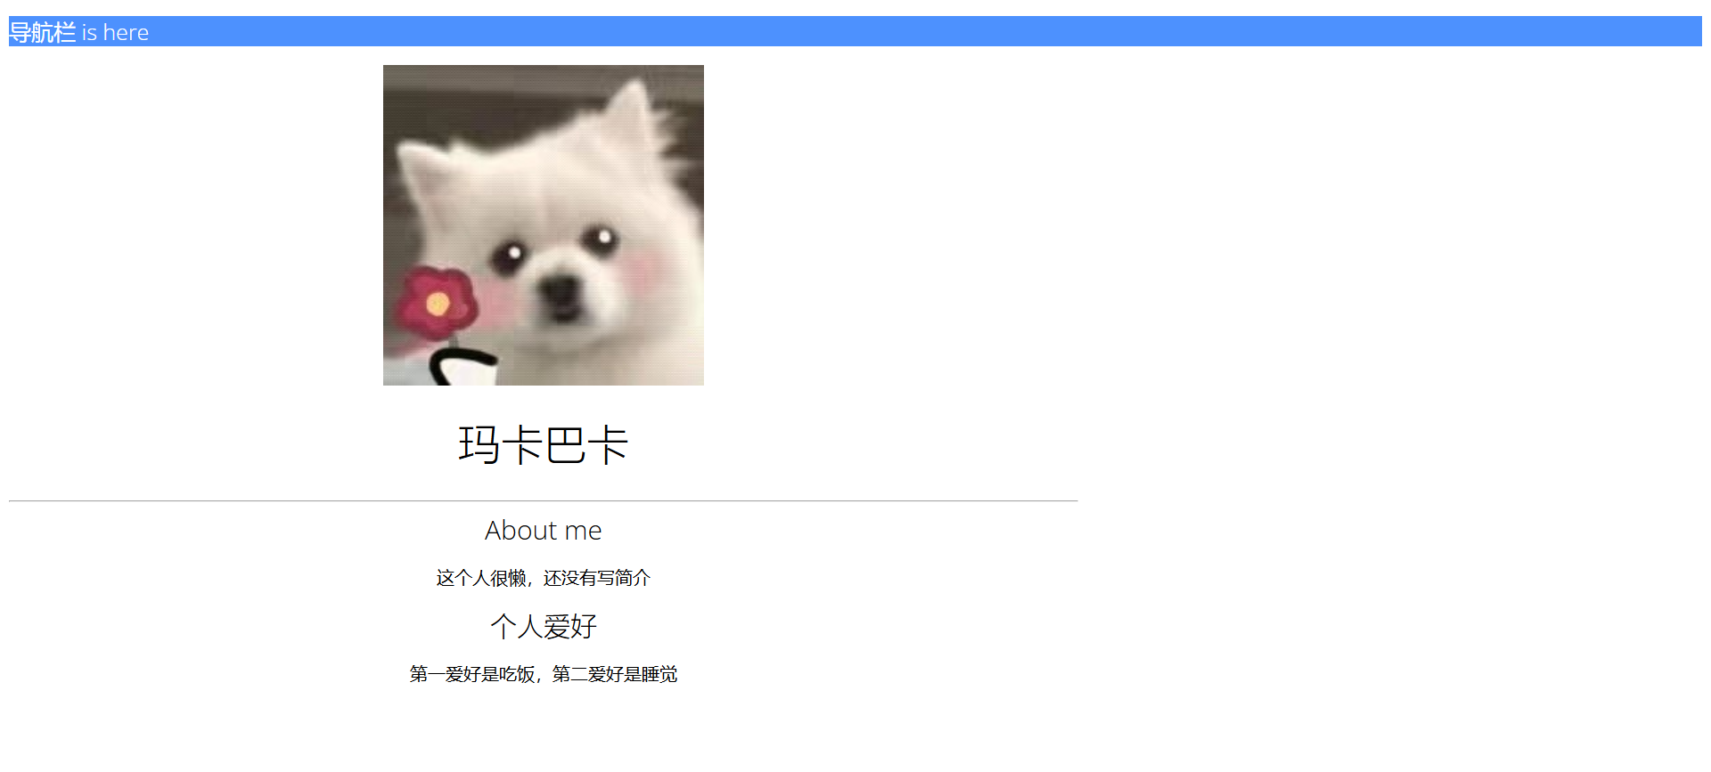
step7 加入导航栏

Slide 41
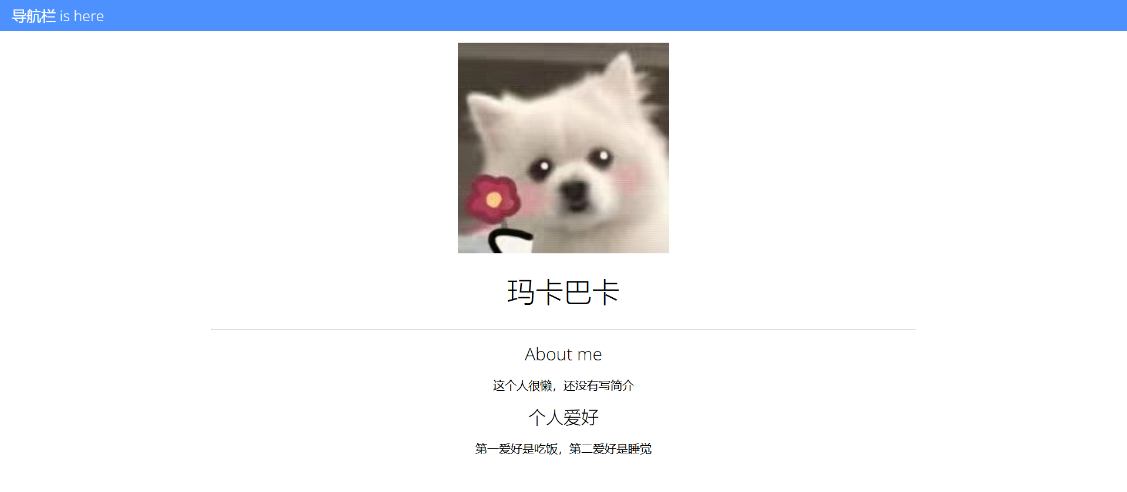
step8 去掉边缘空白&美化

Slide 42
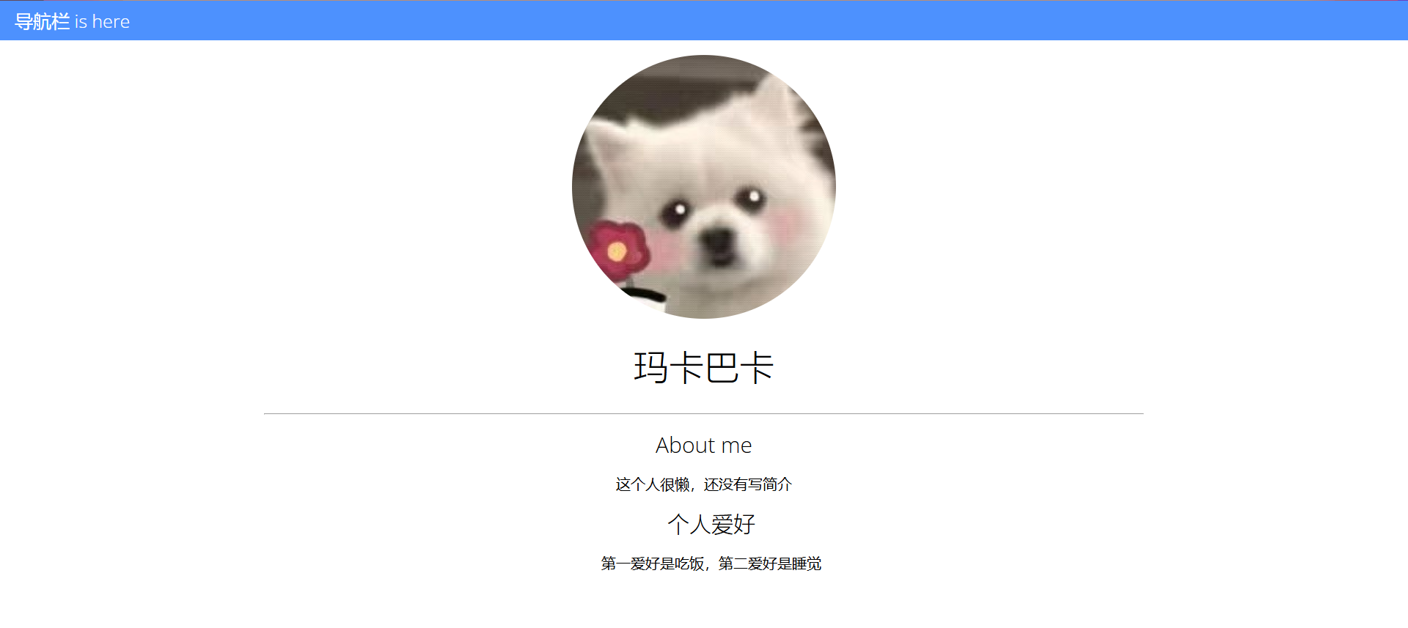
step9 将头像变圆

Slide 43
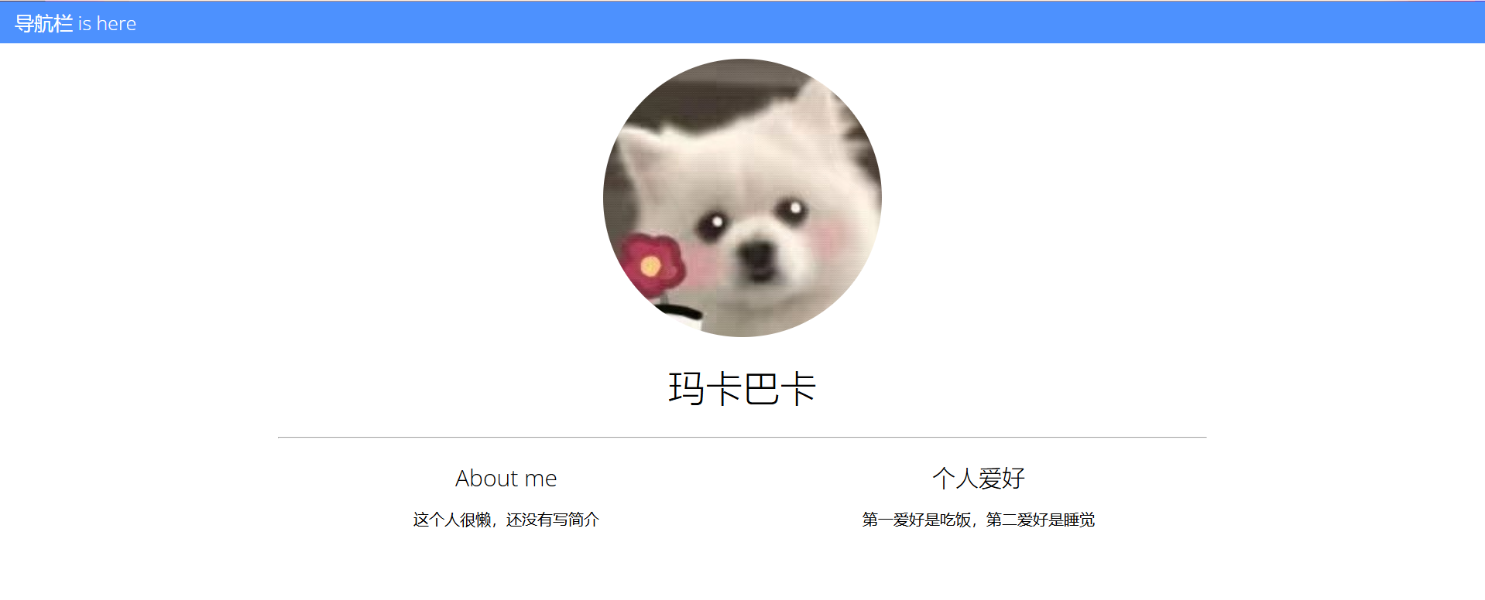
step10 用flex分块

Slide 44
Thanks

